Slide 1


1 September 2026
Weekly Operations Review Meeting

Slide 2
Agenda
Ticket Review(15 Minutes)
Billing Status (6 Minutes)
Projects & Tasks-IT (5 Minutes)
Projects & Tasks-DS (5 Minutes)
Projects & Tasks-SE (5 Minutes)
Product Sales & RFQ Review (6 Minutes)
Any Other Business(AOB),TFTT(6 Minutes)

Slide 3
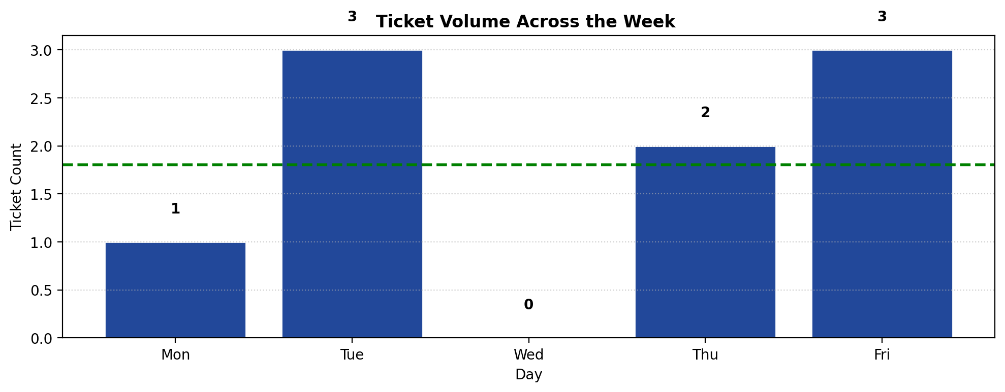
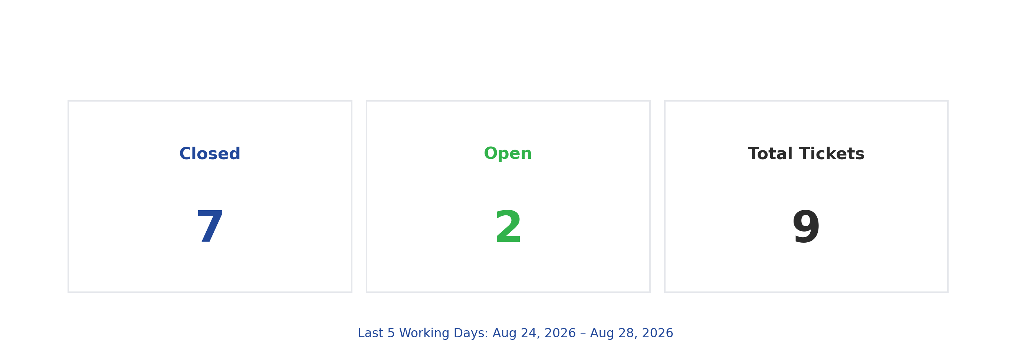
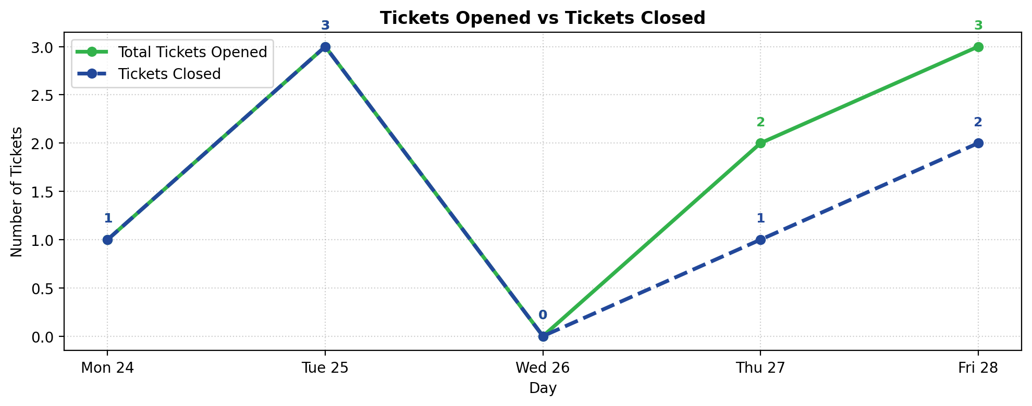
Ticket Review-Volume &Closure Rate

Slide 4
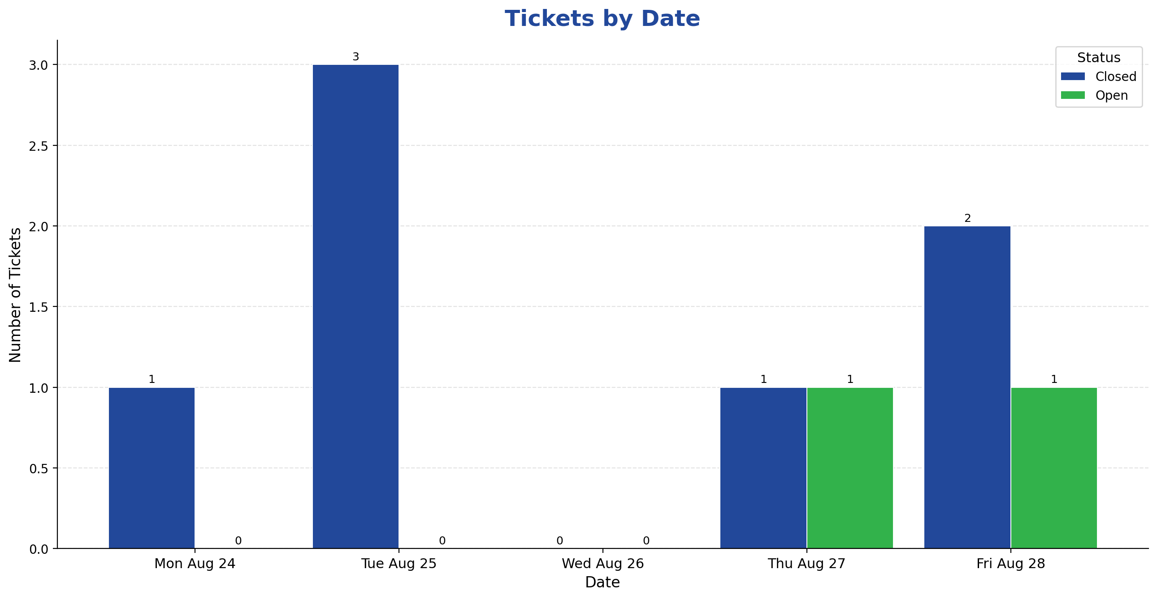
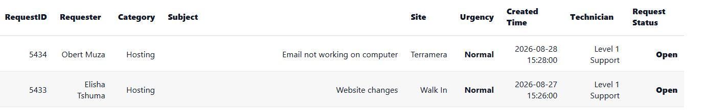
Ticket Review- In Queue

Slide 5
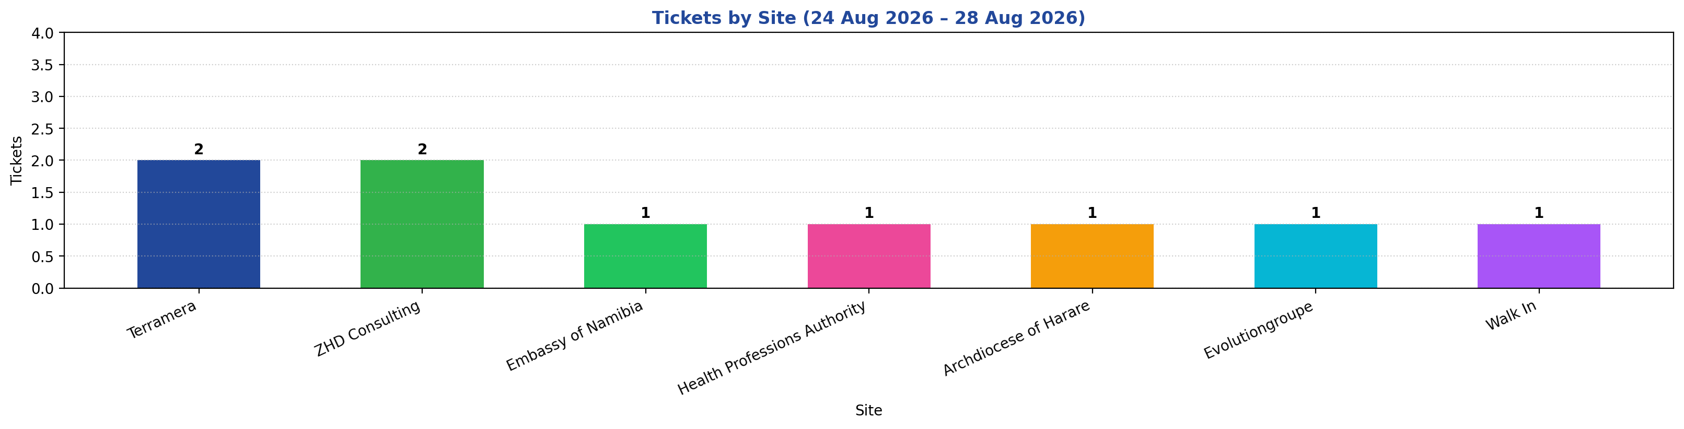
Ticket Review-Last 7 Days

Slide 6
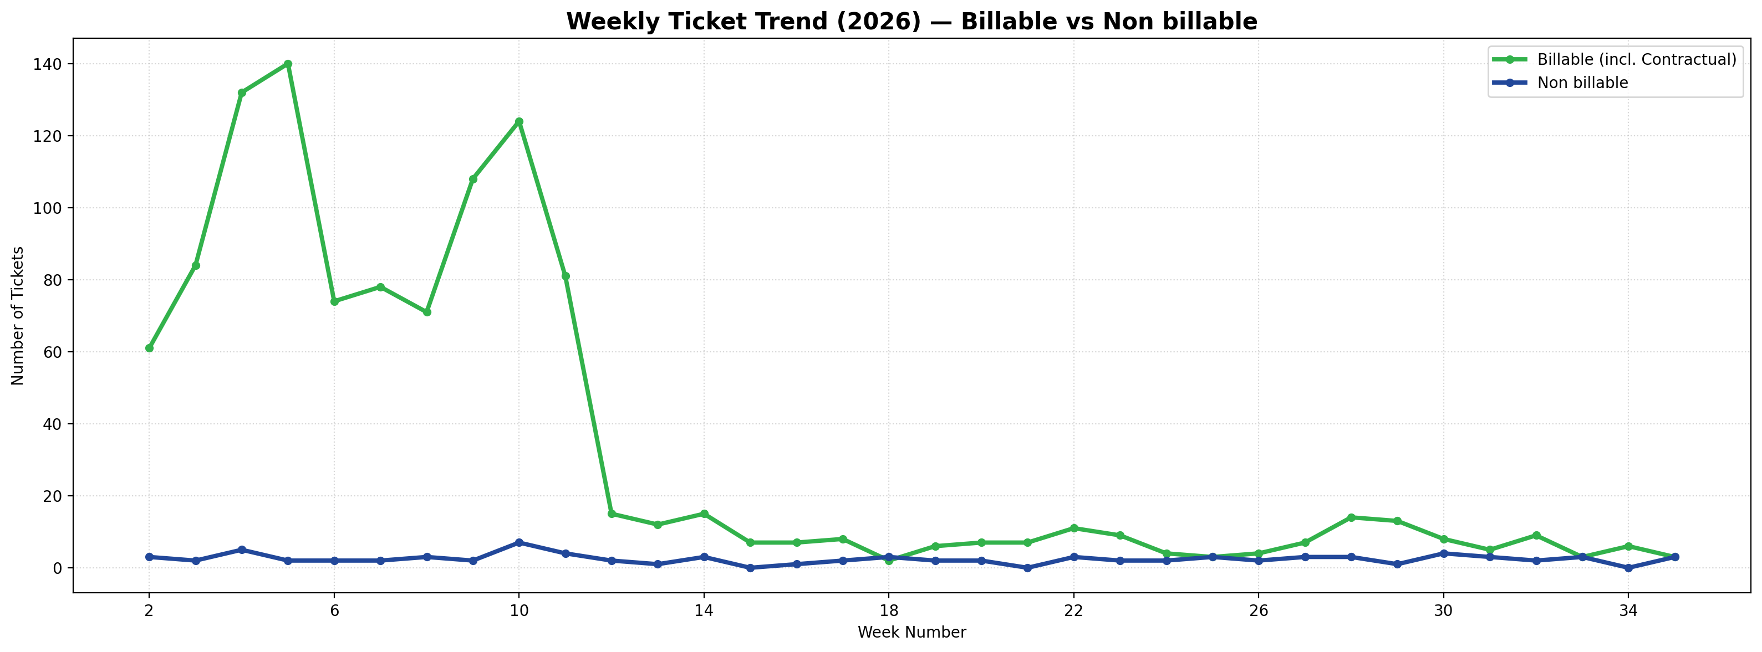
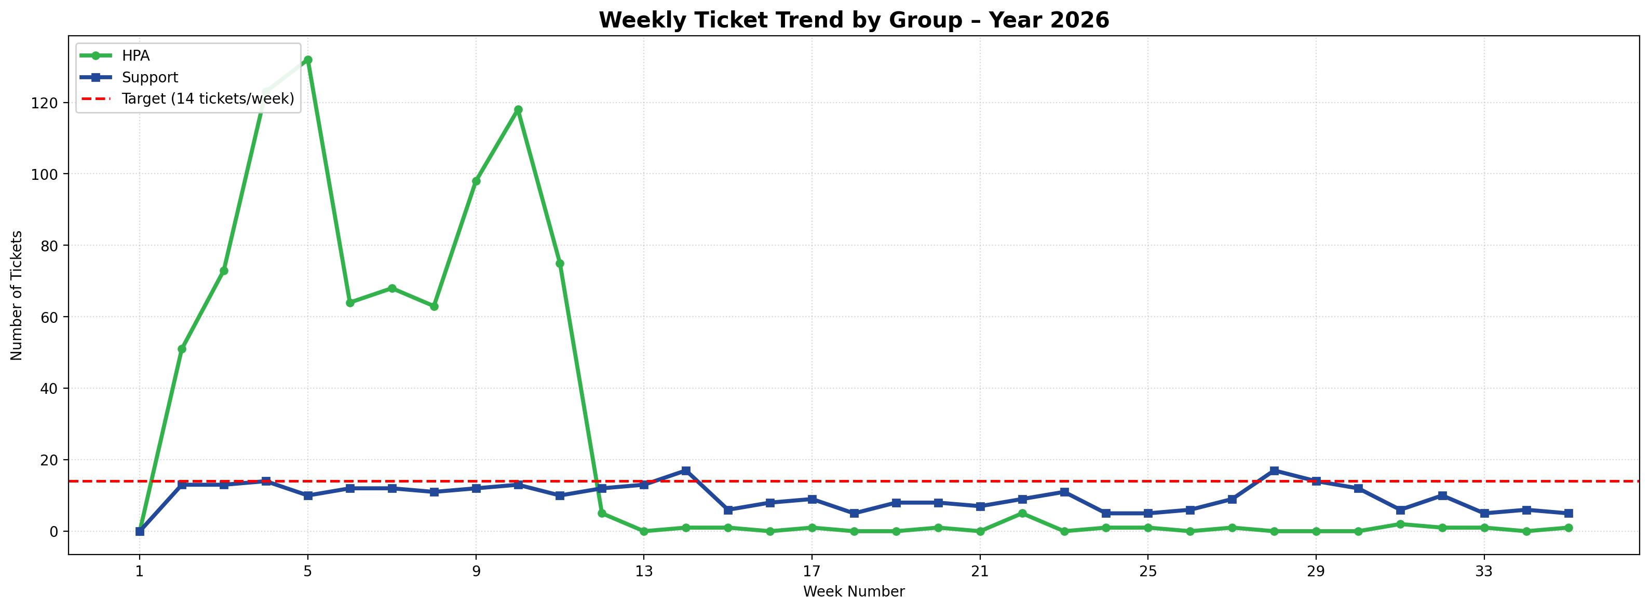
Tickets- Weekly Tracking

Slide 7
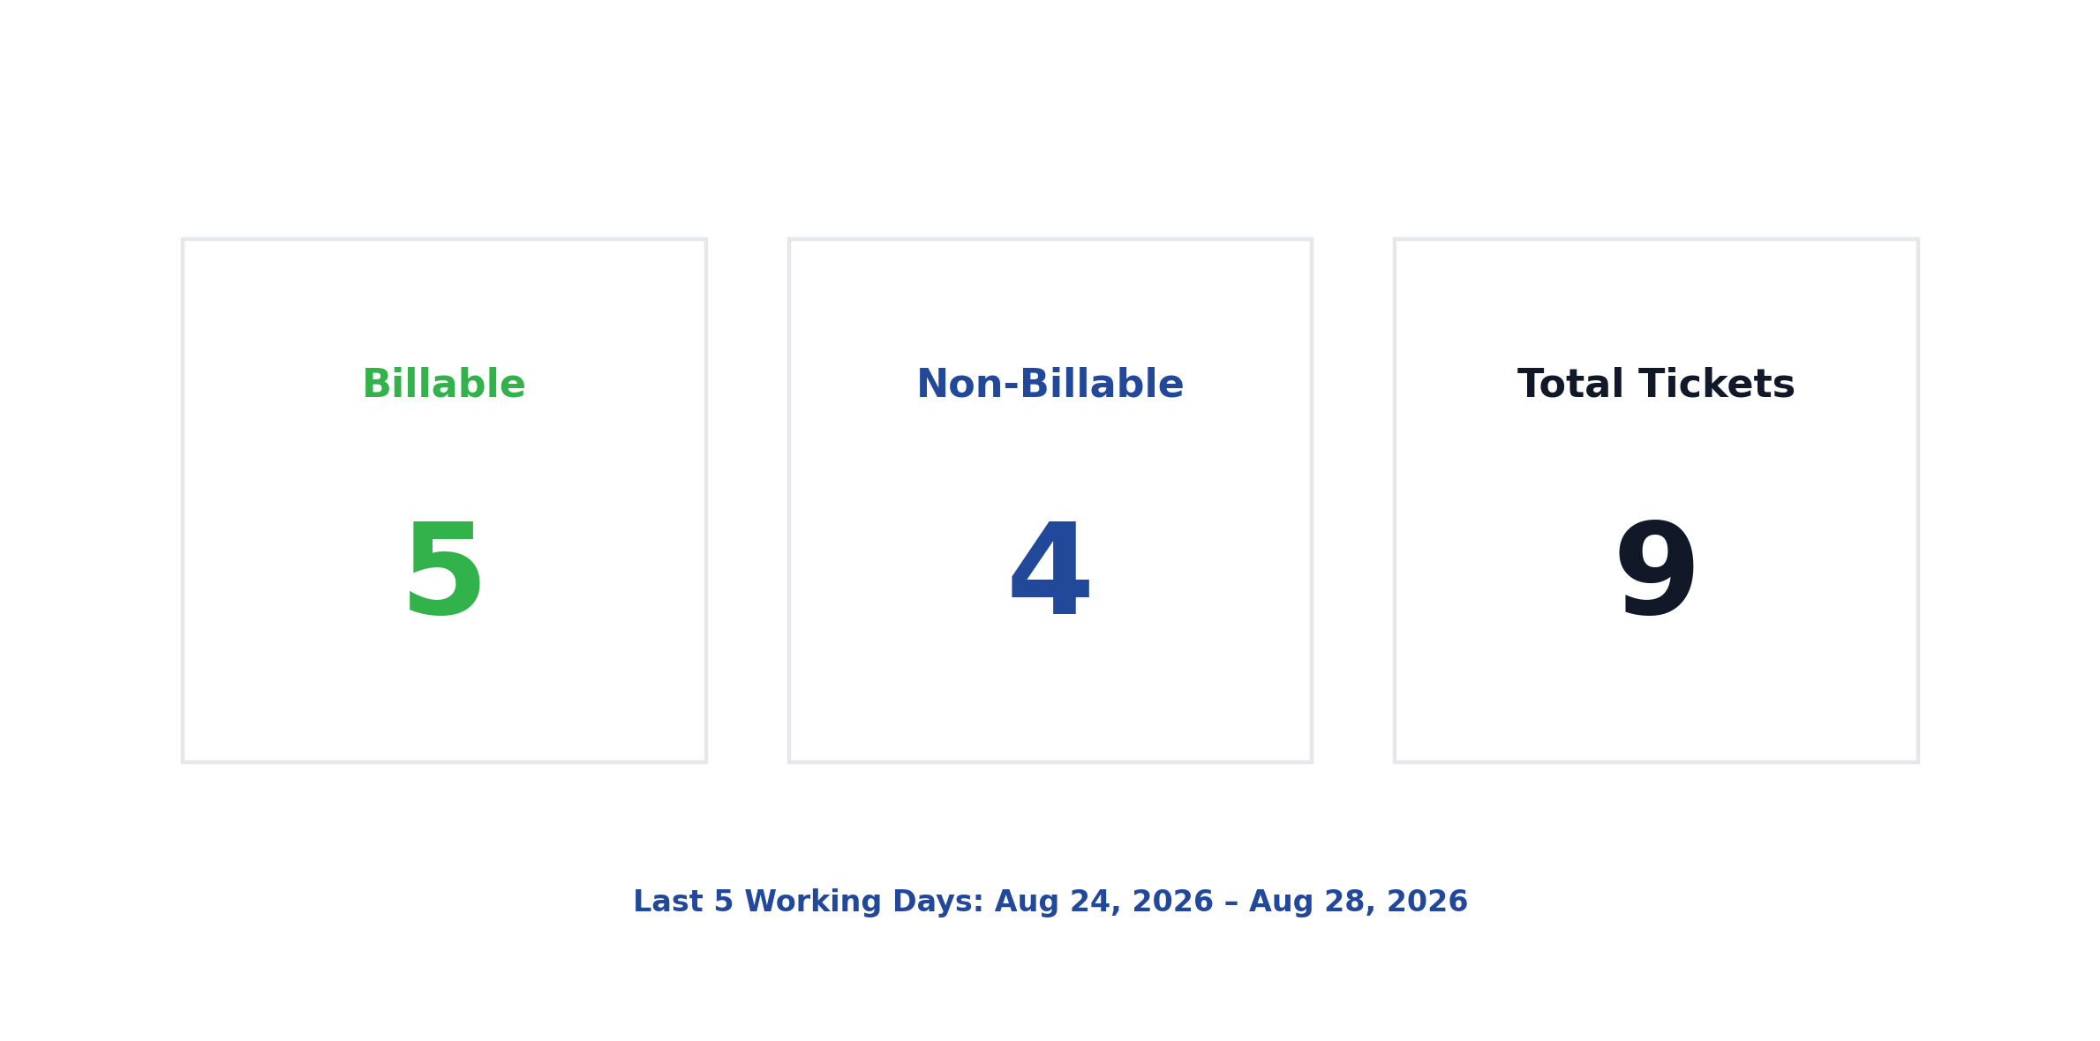
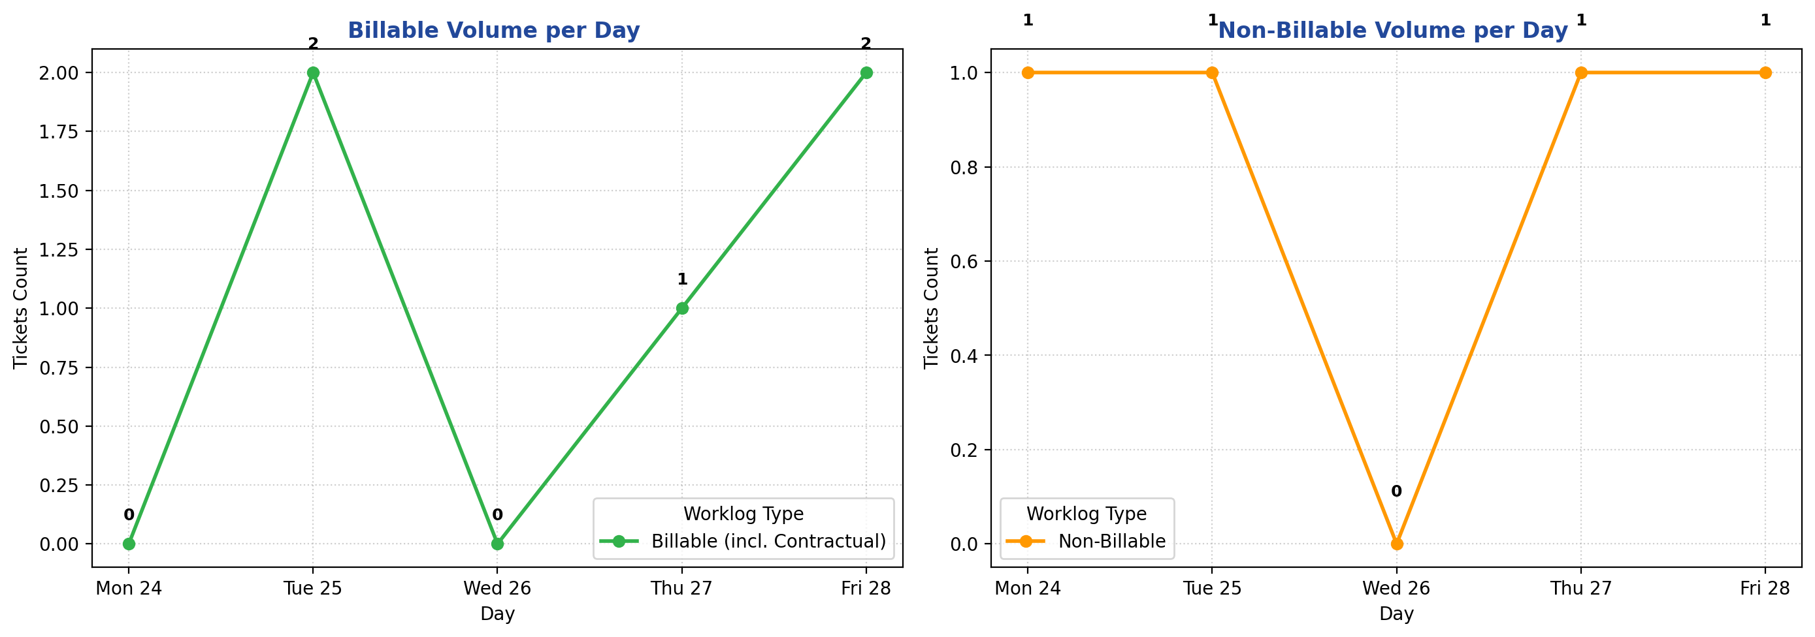
Billing Status- Weekly &Worklogs

Slide 8
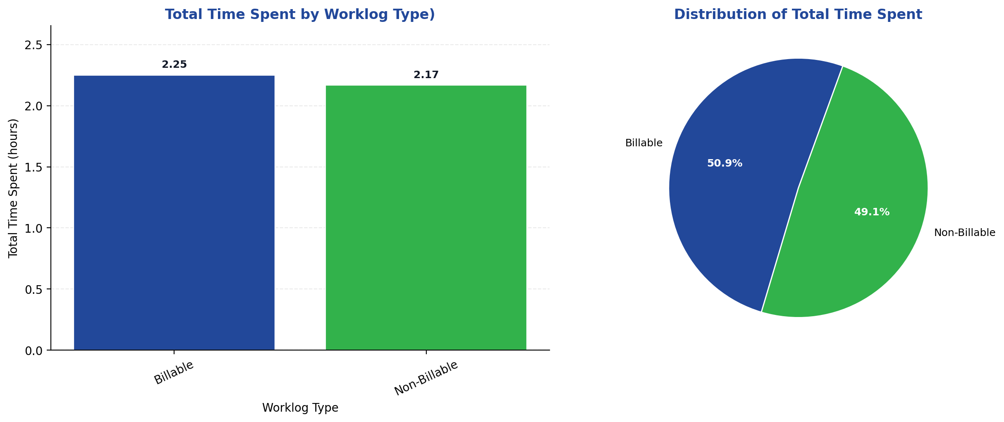
Billing Status-Last Week &Worklogs

Slide 9
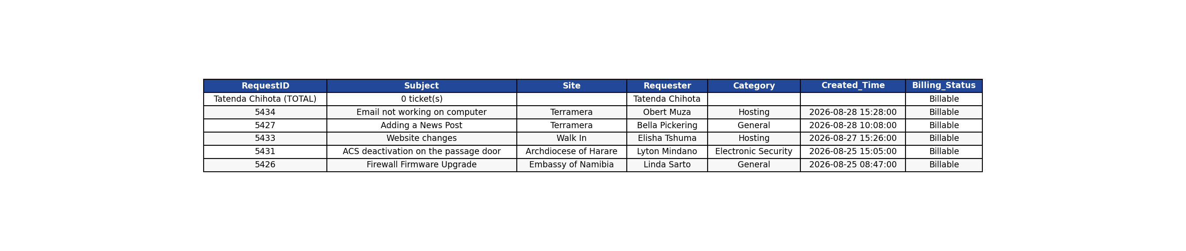


Billing Status-Last Week

Slide 10
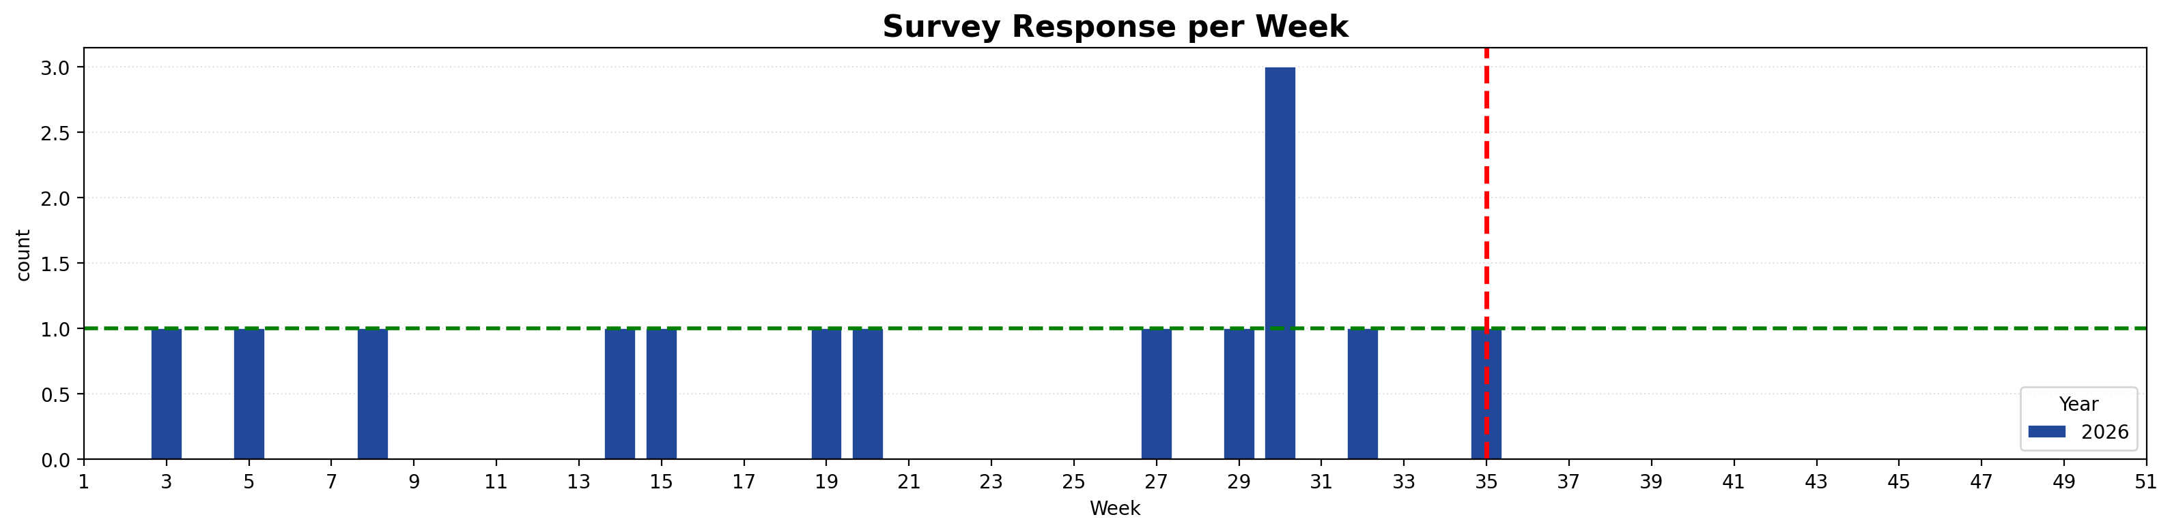
Survey

Slide 11
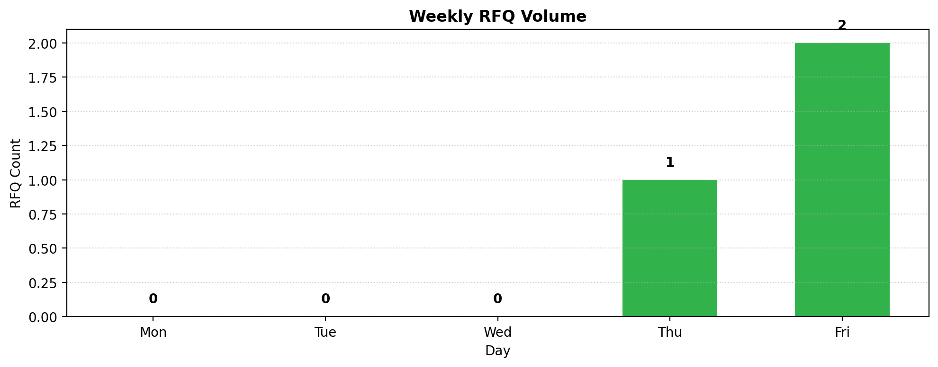
RFQ Review

Slide 12
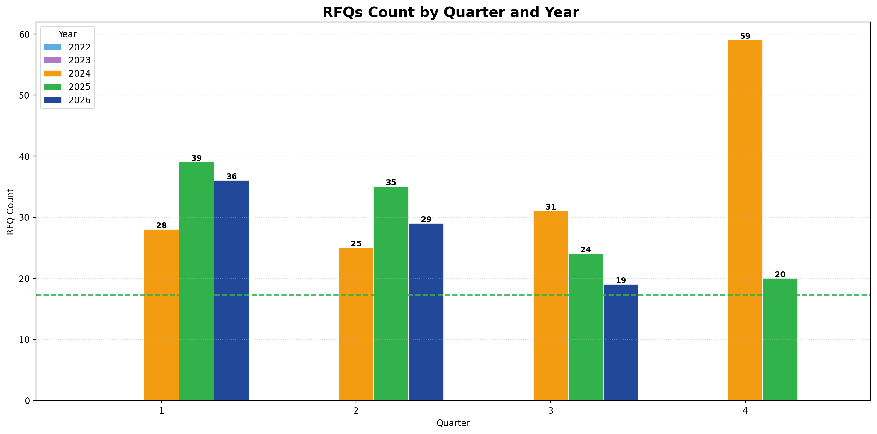
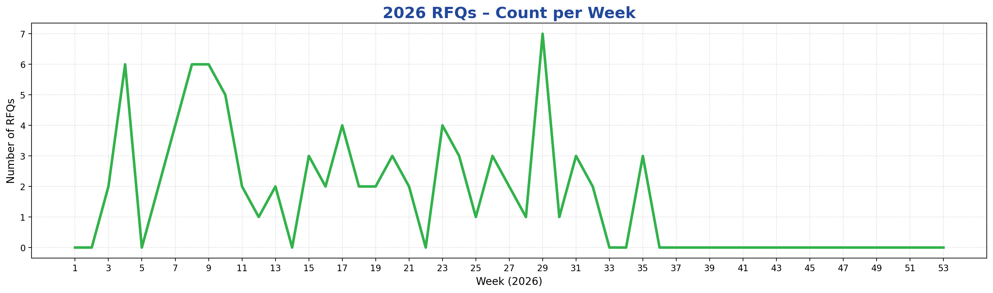
Sales Review

Slide 13
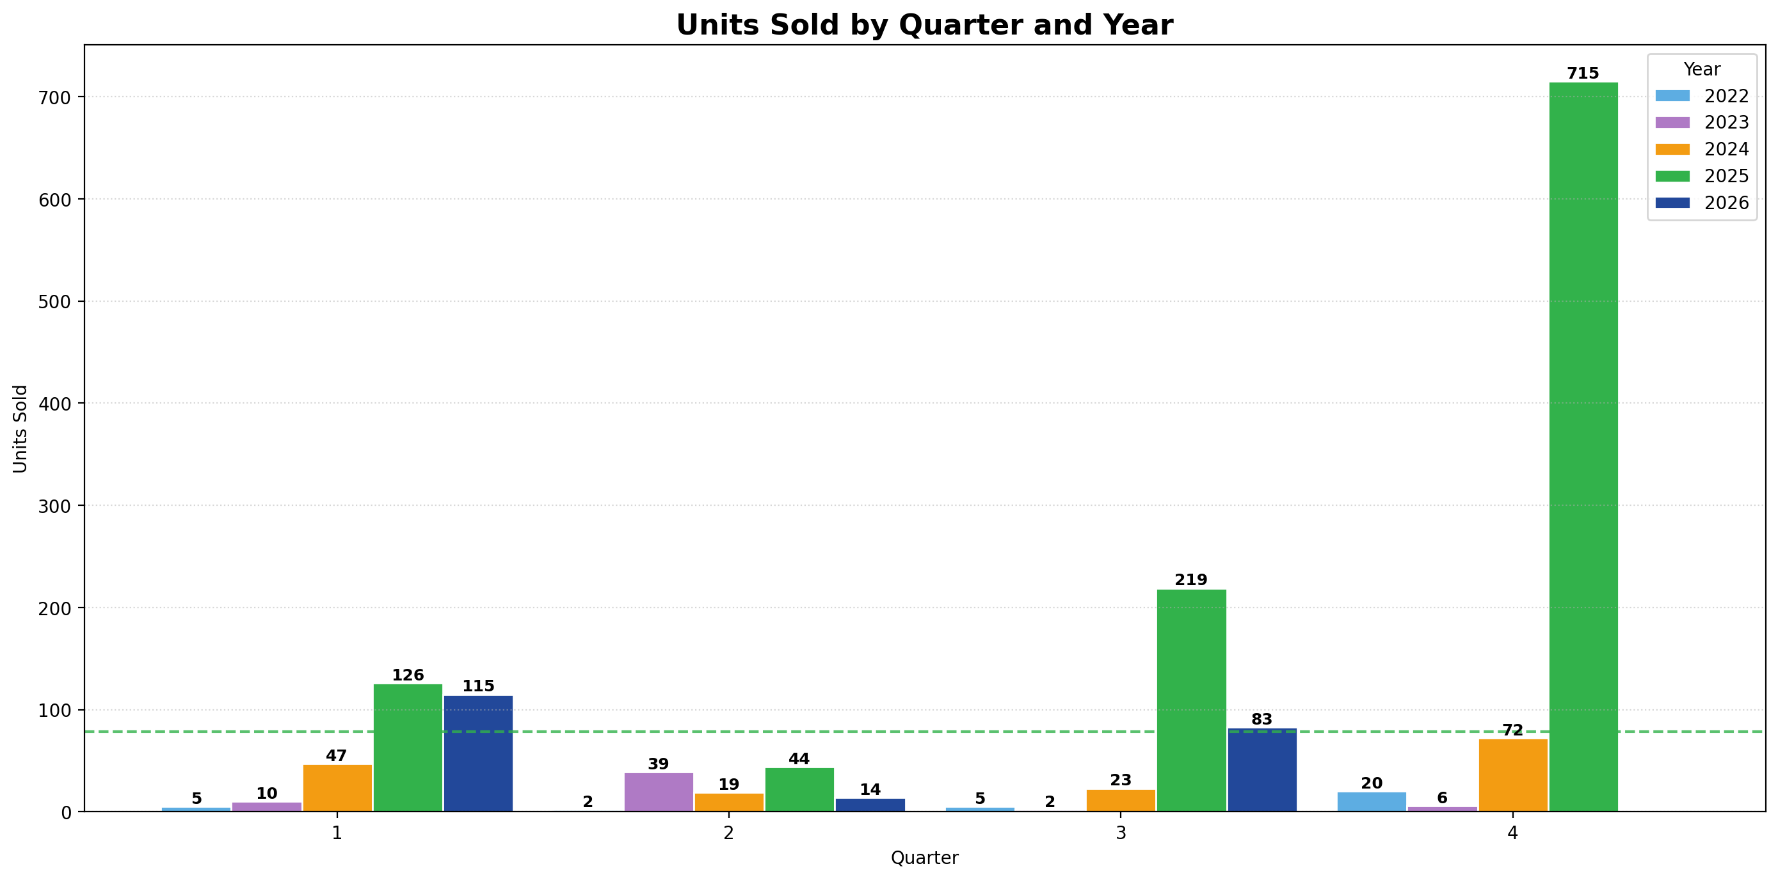
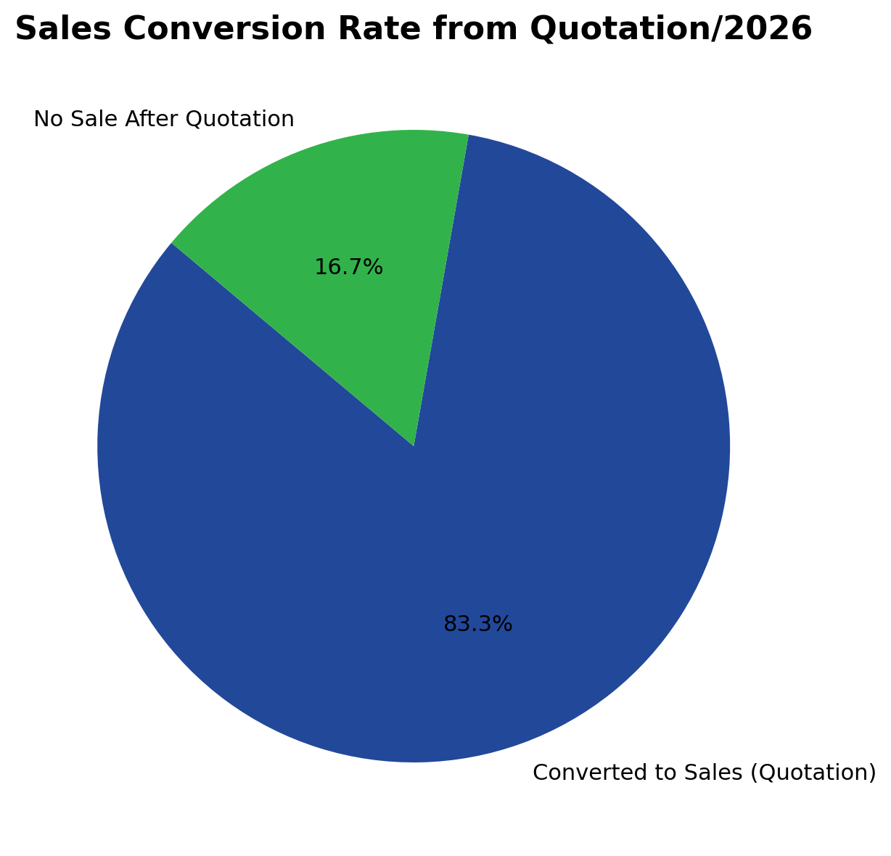
Product Sales

Slide 14
Any Other Business/TFTT Topic

Slide 15
THANK YOU
For Attending this Meeting

